Slide 1
Lessons from SAFER CITIES
Franz Vanderschueren
franzv33@gmail.com

Slide 2
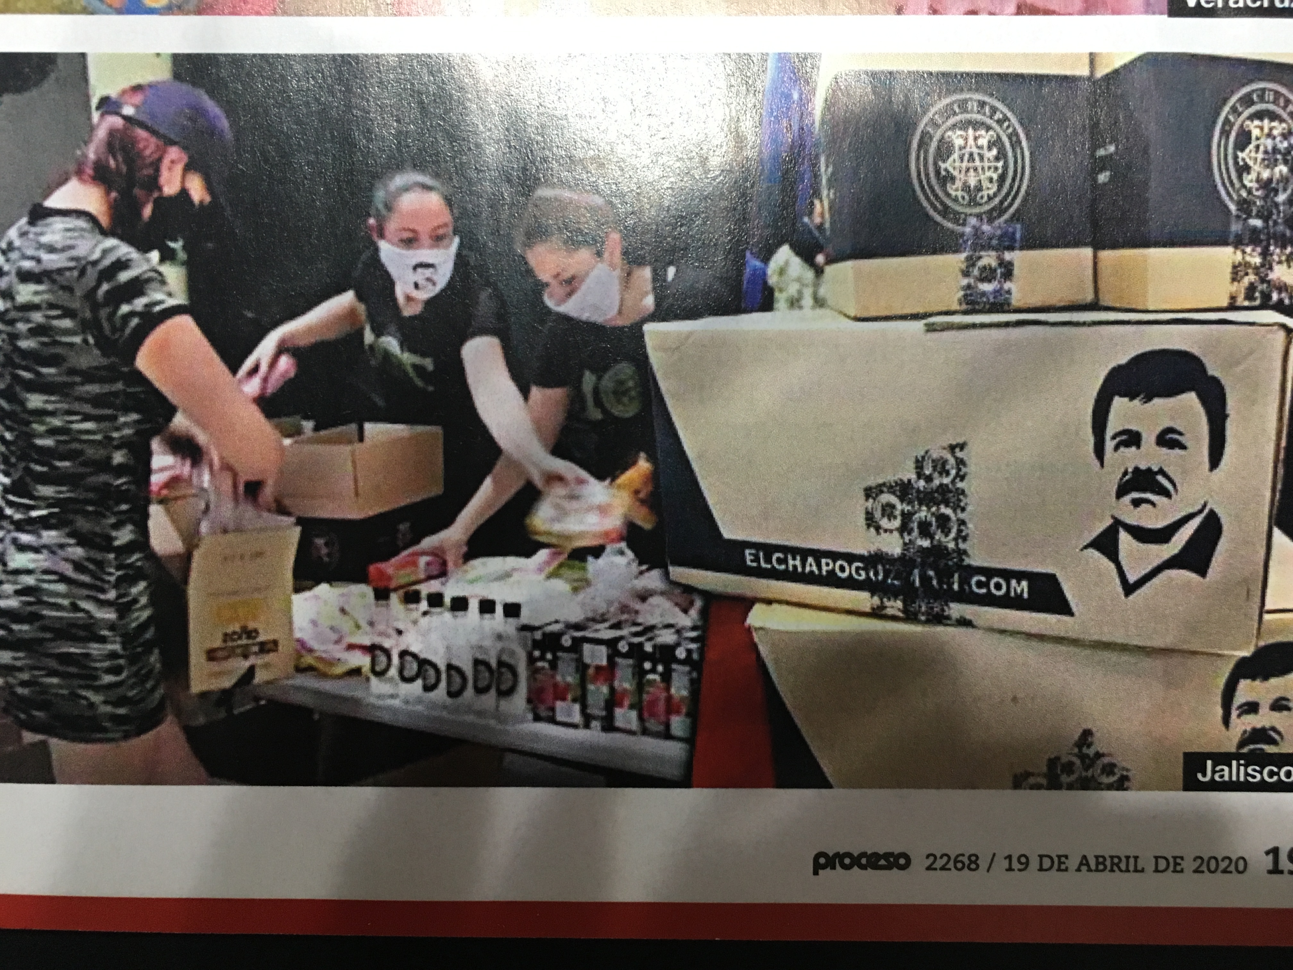
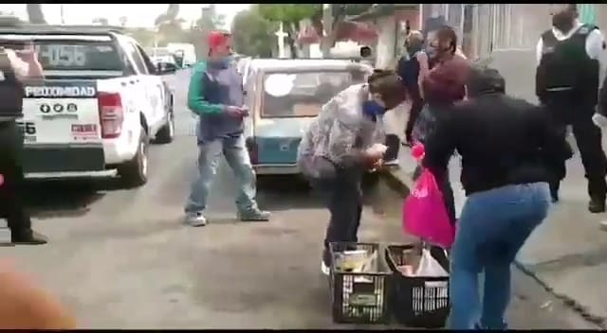
A governance challenge
Coronavirus and the consequent socio economic crisis show the need to a proximity action of the local authorities with police and local communities particularly in low income neighbourhoods
The risk: crisis of governance and social outburst
Safer Cities after 25 years of "territorial proximity“
experience can present some useful tools
Colombia April 2020: Red rags at the windows means hunger
Organized crime helping with food
Nezahualcóyotl (México) municipal and proxy police and neigbourhoods security committee helping the redistribution of foods ( May 2020)

Slide 3
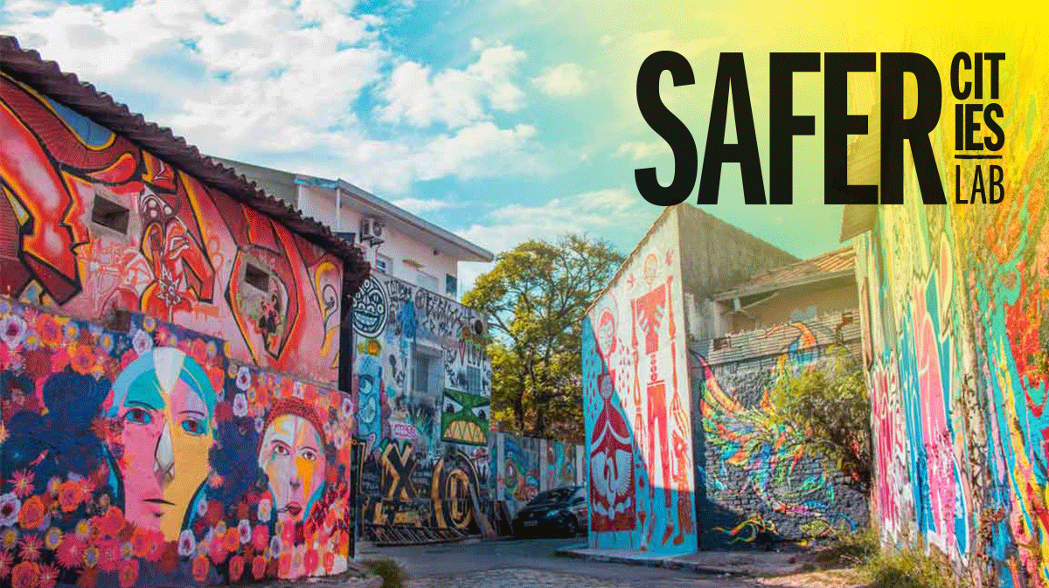
The need for a Safer Cities at local level
The exponential increase in common
crime between 1970 and 1990 has led to
police reforms and private security
emergency of the role of municipalities in
Security management and prevention.,
PERSPECTIVE: urban or citizen´s security.
(ECOSOC 1994) (Barcelona, Medellín and Durban)
A second phenomenon, that of chronic violence, This violence is a single phenomenon that is reproduced through micro and macro processes such as extreme poverty, social inequality, lack of security policies, segregated urbanization, economic models of overexploitation of labor, destruction of natural and man-made environments that leads to the social banalization of corruption of the police, justice and sectors of the State
PERSPECTIVE: human security

Slide 4
Success conditions
The process steps and conditions for success
Leadership and Vision
Financial, social and political support
Monitoring and evaluation
Audit reaching neighbourhood level
Technical team
Training
Plan of action in partnership
Strategy
(axes and priorities)
Communication policy

Slide 5
AUDIT
Capture diverse territorial dynamics
Diagnosis points to:
+ knowledge of local risk factors (human security)
+ strengths and resilience of the population,
+ the assessment of local prevention practices,
+ the discernment of perceptions of insecurity of the various segments of the population.
Focus on Neighborhood priorities
Reaching the neighborhood and community level using typologies:
Ej. LAC
Upper class
Normal
Vulnerable
High complexity
Addresses integrality of factors (Human security)
Provides ad hoc indicators
Facilitates municipal management

Slide 6
Strategy
Strategic axes with specific projects.
Consensus of the local actors to work
in partnerships.
The central orientation of projects or programs
is the co-production of safety in order to reach
quality of life
Key partners: the whole of local management,
youth and police.
Durban

Slide 7
Adaptable tools to UNHABITAT SP ?
External Evaluation
Specialized teams per pillar
Propose changes
Communication policy
Cross cutting local Authority
Guide the process in interacción with communities
Audit reaching neighboorhood level
Ad hoc neighboorhood level organizations
GLOBAL CITY STRATEGY
Comunicate & monitor
processes
Specific strategy and plan of actions

